Slide 1
Bell work
In your notebook, answer the following:
Why is the relationship between teenagers and their parents often difficult?
***Use complete sentences***

Slide 2
Objectives:
By the end of the lesson students will be able to:
Explain the causes of the French and Indian War
Explain how the British won the war
Explain the outcomes of the war on the American colonists

Slide 3
bellwork
In your notebook, answer the following:
Explain how the relationship between teenagers and parents is similar to the Revolutionary War.
***Use complete sentences***

Slide 4
Objectives:
By the end of the lesson students will be able to:
Explain the causes of the French and Indian War
Explain how the British won the war
Explain the outcomes of the war on the American colonists

Slide 5
Unit 1: The American Revolution
(1753–1783)

Slide 6
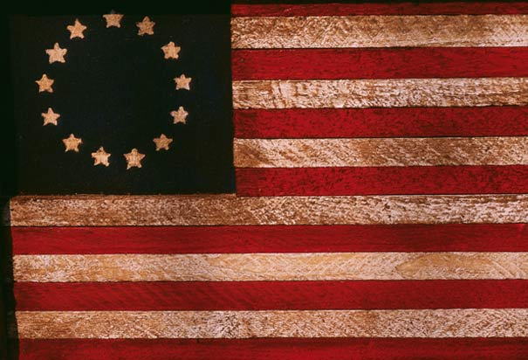
The Road To Independence

Slide 7
The War before “The War”
**French and Indian War**: struggle between French, British, and Native Americans for control of eastern North America.
British and American colonists fought against the French and their Indian allies.

Slide 8
Causes of War
Britain and France claimed the upper Ohio River valley territory.
In June 1754, Benjamin Franklin proposed the **Albany Plan of Union**.

Slide 9
Causes of War
Called for British colonies to unite like the Iroquois by forming the Iroquois League.
Colonists rejected Franklin’s plan
Provided a model for the United States government.

Slide 10
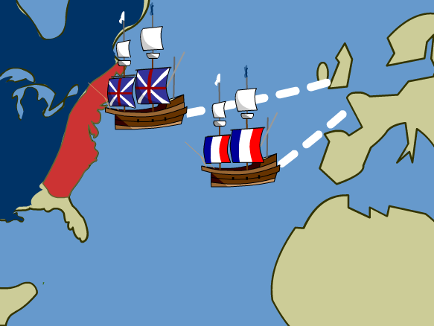
The British Win the War
In 1756, Great Britain formally declared war on France.
Fighting spread to Europe and Asia

Slide 11
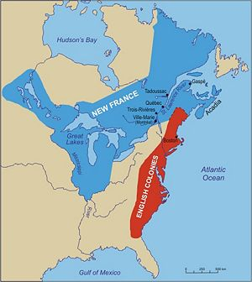
The British Win the War
British invade New France and capture Quebec.
British laid siege to the city - gained control over all of New France.

Slide 12
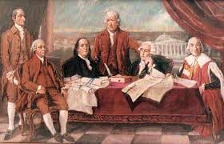
The British Win the War
The Treaty of Paris (1763), officially ended the French and Indian War in America and Seven Years’ War in Europe.

Slide 13
bellwork
In your notebook, answer the following:
Explain the military strategy the British used to win the French and Indian War.
***Use complete sentences***

Slide 14
Unit 1: The American Revolution
(1753–1783)

Slide 15
The Road To Independence

Slide 16
Objectives:
By the end of the lesson students will be able to:
Explain the causes of the French and Indian War
Explain how the British won the war
Explain the outcomes of the war on the American colonists

Slide 17
In your notebook…
Answer the following:
Who was fighting in the Revolutionary War?
Why was the Revolutionary War fought? What issues were behind the war?
What was the result of the war?
Who were some of the important people of the Revolution and explain what they contributed to the Revolution?
***Using Complete Sentences***

Slide 18
Bellwork
What was the name of the document that ended the French and Indian War?

Slide 19
Objectives:
By the end of the lesson students will be able to:
Explain the causes of the French and Indian War
Explain how the British won the war
Explain the outcomes of the war on the American colonists

Slide 20
Weakened Loyalty to Britain
Despite the victory, war strained relations between British and American colonists.
British thought colonists did not provide enough support

Slide 21
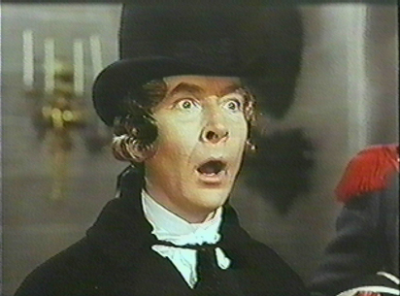
Americans demanded to be led by colonial officers.
American colonists felt a loss of respect for British military power.
Many believed the British did not share the same values as the colonists.

Slide 22
Seeds of the American Revolution
Resentment
Loss of respect
Differing values
Feeling of independence

Slide 23
Did We Meet Our Objectives?
Can you?
Explain the causes of the French and Indian War
Explain how the British won the war
Explain the outcomes of the war on the American colonists
Chapter 4 Lesson 1

Slide 24
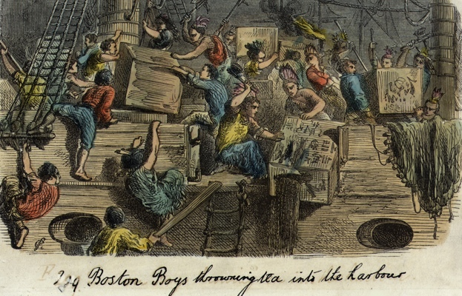
Lesson 2: Issues Behind the Revolution

Slide 25
Objectives
By the end of the lesson, students will be able to:
Explain how and why British policies in colonies changed
Determine the causes and effects of the Stamp Act
Explain how rising tensions led to fighting at Lexington and Concord

Slide 26
Changing British Policy
After the French and Indian War, Native Americans were concerned about British interests.
British represented a greater threat to Native American land

Slide 27
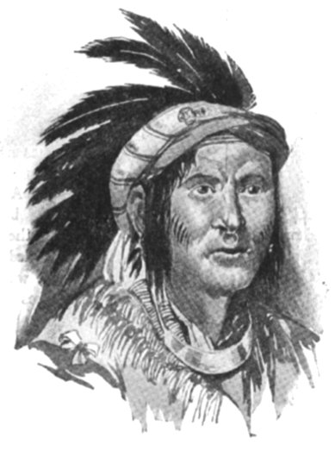
Indians in the Great Lakes rebelled against British occupation.
destroyed British forts in the region - called Pontiac’s Rebellion
King George then issued Proclamation of 1763, closing the Great Lakes region to settlement by colonists.

Slide 28
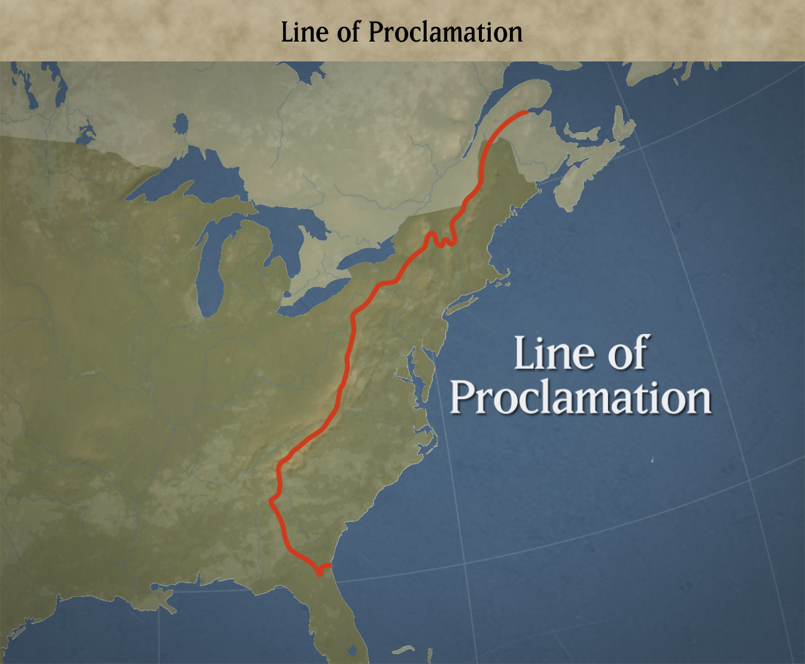
Colonists ignored the proclamation and continued to settle in forbidden areas. further undermining its authority in America.

Slide 29
Task
Color and label the original 13 colonies
Draw and label the Proclamation Line of 1763

Slide 31
Bell work
Why did the Native Americans become increasingly upset with the Colonists?

Slide 32
Objectives
By the end of the lesson, students will be able to:
Explain how and why British policies in colonies changed
Determine the causes and effects of the Stamp Act
Explain how rising tensions led to fighting at Lexington and Concord

Slide 33
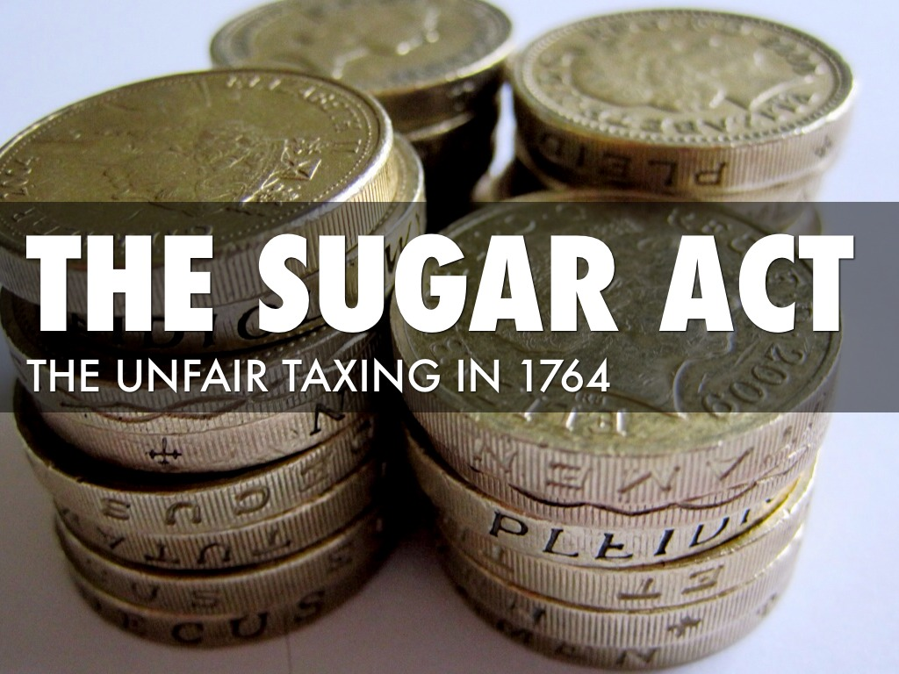
The Sugar Act
Designed to raise more income
Required smuggling cases be tried in British court
Judge would receive 5% commission on guilty verdicts

Slide 34
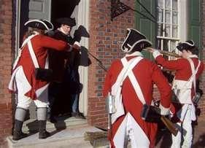
The Quartering Act
Forced colonists to provide housing and supplies for British troops

Slide 35
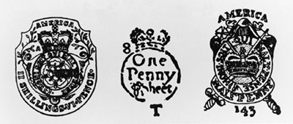
The Stamp Act Crisis
In 1765, British Parliament passed the Stamp Act.
This law placed a tax on newspapers, pamphlets, legal documents, and most other printed materials.

Slide 36
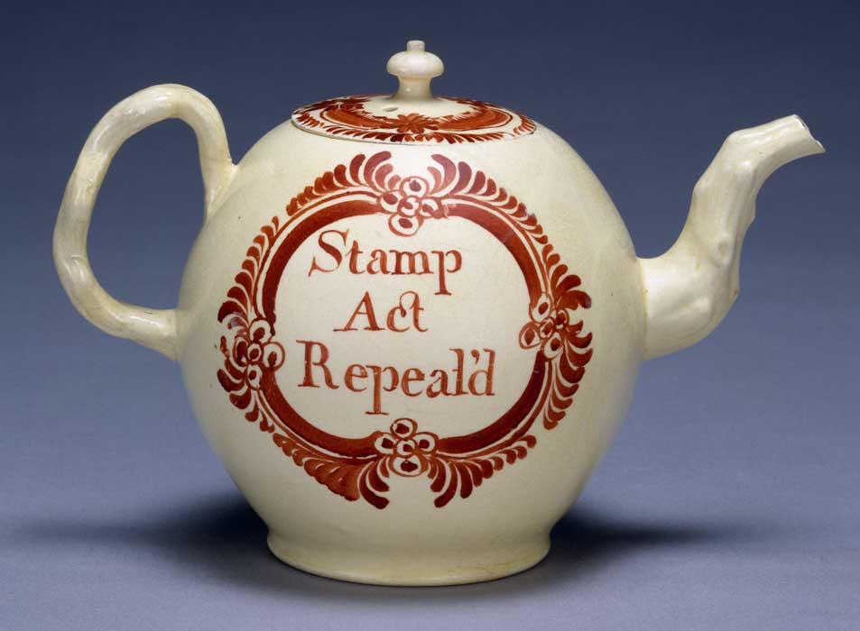
By November 1765, when the Stamp Act was to take effect, most stamp distributors had resigned or fled, leaving no one to sell the stamps.
In 1766, Parliament repealed the Stamp Act.

Slide 37
Rising Tensions in the Colonies
In 1767, Parliament passed the Townshend Acts put import taxes on certain goods, such as glass and tea.

Slide 38
British troops were sent to Boston to put down resistance to the Townshend Acts.
In March 1770, a small crowd threatened the British soldiers.

Slide 39
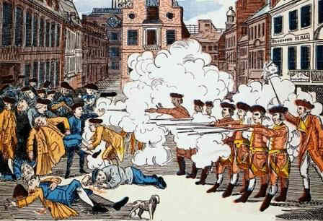
Known later as the Boston Massacre, the soldiers opened fire and killed five colonists.
Soon after, Parliament canceled all the Townshend taxes, except for the duty on tea.

Slide 40
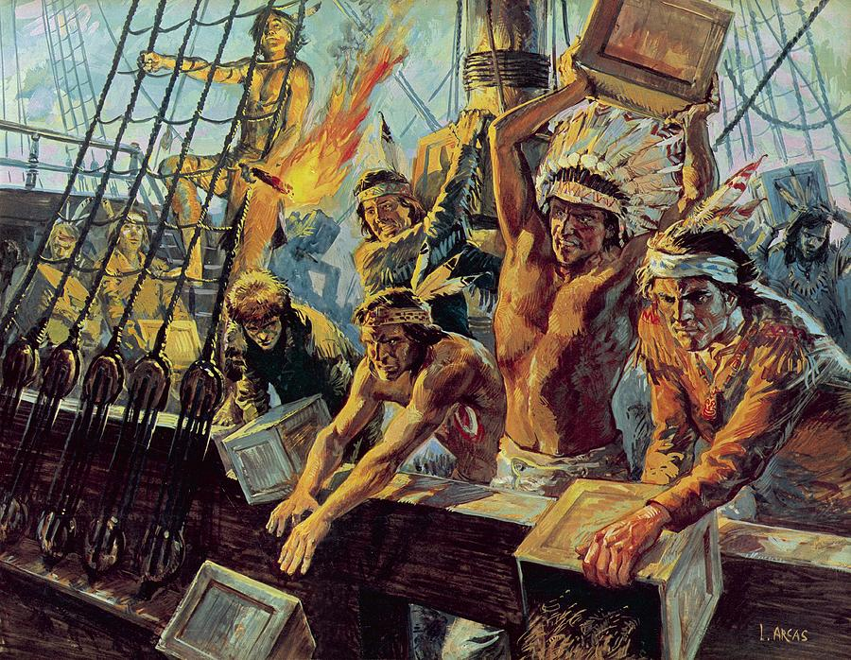
Tea Act – gave a British company special tax exemption in the colonies.
On December 16, 1773, colonists boarded three tea ships in Boston and dumped all of the tea into the harbor.

Slide 41
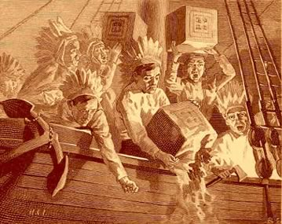
This incident became known as the Boston Tea Party.

Slide 42
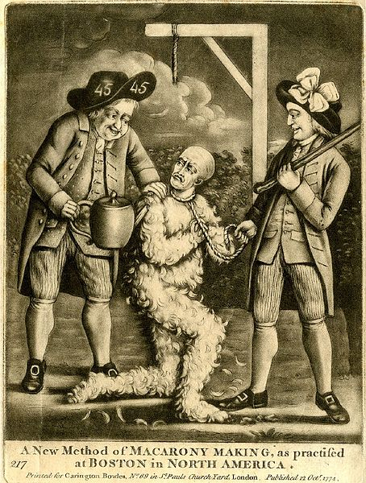
In 1774, Parliament passed a series of laws known as the Coercive Acts - to punish Massachusetts.
Colonists called them the Intolerable Acts.

Slide 43
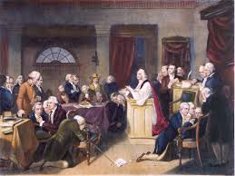
56 delegates met in Philadelphia at the First Continental Congress.
The delegates decided to renew a boycott of British goods and organize armed **militias**.
They also made a direct appeal to the king

Slide 44
bellwork
Give an explanation of the following:
Coercive Acts
Tea Act
Townshend Act

Slide 45
Objectives
By the end of the lesson, students will be able to:
Explain how and why British policies in colonies changed
Determine the causes and effects of the Stamp Act
Explain how rising tensions led to fighting at Lexington and Concord

Slide 46
Lesson 2: Issues Behind the Revolution

Slide 47
Fighting at Lexington and Concord
The Americans whom King George had labeled “rebels” called themselves Patriots.
They followed the call of the First Continental Congress and began to form armed militias.
They had to be ready for battle on a minute’s notice.
minute men.

Slide 48
Massachusetts Patriots gathered guns and ammunition and stored a major stockpile in Concord, a town about 20 miles from Boston.
On April 18, 1775, a force of about 800 British troops moved out of Boston to seize the weapons.

Slide 49
Paul Revere
In the spring of 1775, most Patriot leaders taken refuge in outlying communities, fearing arrest by British officials.
Remaining in Boston were a few leaders including Paul Revere, a trusted messenger
Paul Revere or Jack Black? You decide…

Slide 50
Task
Map the following:
Battles of Lexington and Concord
Boston
Charlestown
Routes of Revere, Dawes, and Prescott

Slide 51
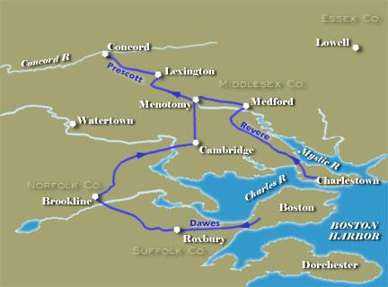

Slide 52
On the 16th of April he made a trip to Concord, the temporary home of the Provincial Congress and also a storehouse for militia guns, powder and shot.
Revere’s warning was taken to heart and the townspeople began to hide arms and valuables in barns, wells and the neighboring swamps.

Slide 53
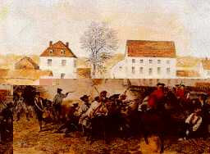
When the main British force arrived at Lexington, about five miles
from Concord, they encountered an armed militia.
The battles that
ensued became
known as the Battles of
Lexington and Concord

Slide 54
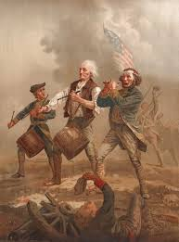
The Battles of Lexington and Concord sparked the Revolutionary War, which became a war for American independence from Britain.

Slide 55
Bellwork
What did the colonists call the Coercive Acts?

Slide 56
Objectives
By the end of the lesson, students will be able to:
Explain how and why British policies in colonies changed
Determine the causes and effects of the Stamp Act
Explain how rising tensions led to fighting at Lexington and Concord

Slide 58
Did We Meet Our Objectives?
Can you?
Explain how and why British policies in colonies changed
Determine the causes and effects of the Stamp Act
Explain how rising tensions led to fighting at Lexington and Concord

Slide 59
Bellwork

Slide 60
Objectives:
By the end of the lesson, students will be able to:
Explain the importance of Thomas Paine’s Common Sense
Summarize the ideas and arguments in the Declaration of Independence.

Slide 61
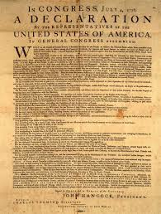
Lesson 3: Ideas Behind the Revolution

Slide 62
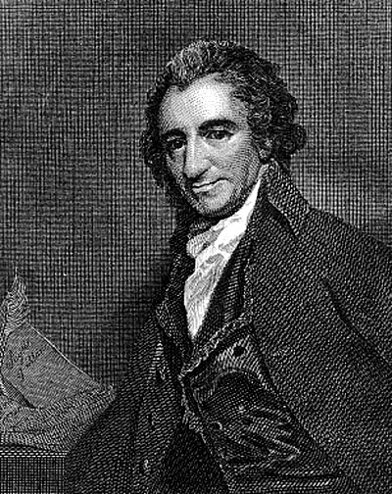
Common Sense
Common Sense, a pamphlet
written by Thomas Paine, was
an important document during
the Revolution.
Paine wrote about the importance of armed struggle against the British Empire and the importance of American independence.

Slide 63
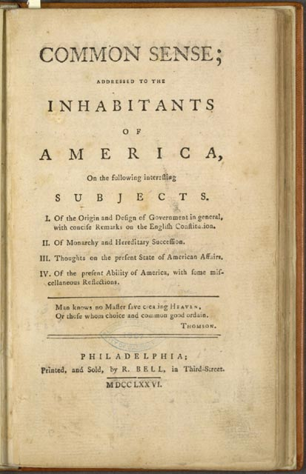
The pamphlet was written in a simple, direct style, appealed to the American people.
Common Sense convinced many to support a complete—and likely violent—break with Britain.

Slide 64
The Declaration of Independence
Common Sense appeared at the same time as the meeting of the Second Continental Congress in Philadelphia that met less than a month after the Battles of Lexington and Concord, and continued through the Revolution.

Slide 65
The Congress sent an
Olive Branch Petition to
King George III.
This petition expressed
the colonists’ loyalty to the king and a halt in fighting until a solution could be found.
The king refused the petition.

Slide 66
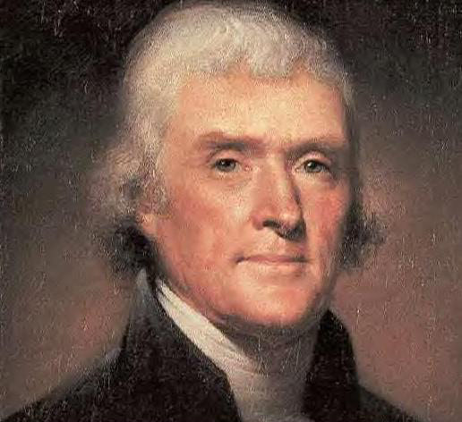
In June 1776, the Congress decided it was time for the colonies to cut ties with Britain.
They prepared a statement of the reasons for separation—a Declaration of Independence.
Thomas Jefferson drafted the statement.

Slide 67
Drafting a Declaration
Jefferson’s ideas were influenced by the Enlightenment, a movement that emphasized science and reason as keys to improving society.

Slide 68
Jefferson divided the Declaration into four sections:
The preamble, or introduction, explained the Declaration’s purpose.
In the declaration of rights, Jefferson believed people have natural rights—rights that belong to them simply because they are human. Jefferson called these unalienable rights, meaning rights that could not be taken away.

Slide 69
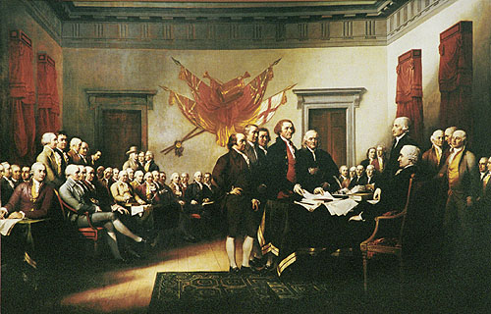
In the complaints against the king - public officials make decisions based on law, not on personal wishes. He called this a rule of law.
The resolution, in declaring the colonies free and independent states, concluded the Declaration.

Slide 70
Jefferson’s document not only declared the nation’s independence, it also defined the basic principles on which American government and society would rest.
Congressional delegates voted to approve the Declaration on July 4, 1776.

Slide 71
Did We Meet Our Objectives?
Can you?
Explain the importance of Thomas Paine’s Common Sense
Summarize the ideas and arguments in the Declaration of Independence.

Slide 72
Bell Work
What are some things that kids your age complain about?

Slide 73
Objectives
By the end of this lesson, students will be able to:
Identify what it means to be an American citizen.
Explain how social capital strengthens a republic?

Slide 74
BELLWORK
Which Continental Congress declared independence from Great Britain (England)?
The First Continental Congress
The Second Continental Congress
The Third Continental Congress
The Fourth Continental Congress

Slide 75
Objectives:
By the end of this lesson, students will be able to:
Explain the events and outcomes of the Siege of Boston
Detail the strengths and weaknesses of the British and American forces
Explain why the Battle of Saratoga is considered the turning point of the war.

Slide 76
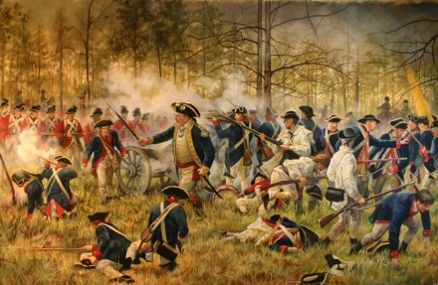
Lesson 4: Fighting for Independence

Slide 77
The Siege of Boston
After Lexington and Concord, 20,000 Patriots surrounded Boston
The British won the Battle of Bunker Hill,
Almost half the British soldiers were killed or wounded.
Patriot casualties numbered fewer than 400.

Slide 78
Task
Map the Battle of Bunker Hill using colors to identify American/British victory

Slide 80
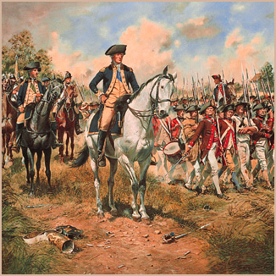
In July 1775, George Washington arrived
British abandoned Boston taking 1,000 Loyalists, or people who remained loyal to Great Britain.
Some Loyalists fled to England, the West Indies, or Canada.
Many remained in the colonies.

Slide 81
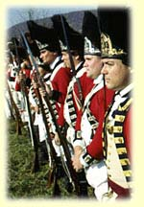
Strengths and Weaknesses
The British
well-trained and equipped army, and the finest navy in the world.
Assistance from Loyalists, African Americans, Native Americans, and mercenaries—foreign soldiers who fight for pay.

Slide 82
Weaknesses: The war was unpopular at home.
Many British resented paying taxes to fight the war and sympathized with the Americans.
Troops had to fight in hostile territories

Slide 83
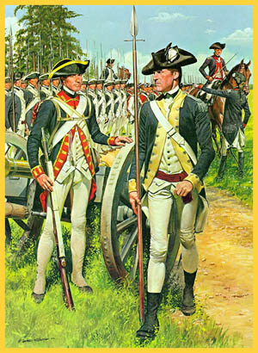
The Americans
Patriots fighting on their own territory.
familiar with fighting tactics from the French and Indian War.
More African Americans served with American forces
Weaknesses: lacked a well-equipped and effective fighting force.

Slide 84
Bell Work
What were the strengths and weaknesses of the American fighters?

Slide 85
Objectives:
By the end of this lesson, students will be able to:
Explain the events and outcomes of the Siege of Boston
Detail the strengths and weaknesses of the British and American forces
Explain why the Battle of Saratoga is considered the turning point of the war.

Slide 86
Lesson 4: Fighting for Independence

Slide 87
Fighting in the North
By winter of 1776, the British captured New York City and pushed Continental Army into Pennsylvania.
Many troops deserted the Continental Army, and the cause seemed on the point of collapse.

Slide 88
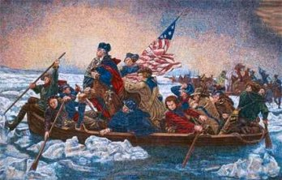
George Washington abandoned
the army tradition of not fighting
during winter.
American troops landed in New Jersey and surprised about 1,400 mercenaries—called Hessians because they were mostly from the German province of Hesse.
Delaware River on Christmas night.

Slide 89
Task
Map and label the Delaware River

Slide 91
The battle was called the
Battle of Trenton
nearly the entire Hessian force was captured, Americans suffered only five casualties.
A similar victory in Princeton, New Jersey, boosted Patriot morale and convinced Americans to support the Patriot cause.

Slide 92
Task
Map and label the Battles of Trenton and Princeton using color to denote American/British victory

Slide 94
Victory at Saratoga
Despite the increasing Patriot numbers and the victories in New Jersey, the Patriots still suffered defeats.
British were attempting to cut off New England from the rest of the colonies.
Americans attacked and
defeated British forces in New York in the Battle of Saratoga.

Slide 95
victory at Saratoga brought a foreign aid to American cause.
France entered the war
on the side of the Americans, followed by Spain and Netherlands.
These alliances provided needed supplies, troops, and a navy.
In addition, Britain now had to defend itself in Europe.

Slide 96
Task
Map and label the Battle of Saratoga using color to denote American/British victory

Slide 98
Did We Meet Our Objectives?
Can you?
Explain the events and outcomes of the Siege of Boston
Detail the strengths and weaknesses of the British and American forces
Explain why the Battle of Saratoga is considered the turning point of the war

Slide 99
BELL WORK
What was the effect of the Patriot’s victory at the Battle of Saratoga?

Slide 100
Objectives:
By the end of this lesson, students will be able to:
Identify hardships of the Americans during the war
Explain how American victories in the West and South ended the war
Summarize the impact of the American Revolution

Slide 101
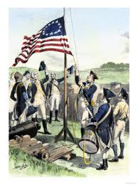
Winning Independence

Slide 102
Americans Endure Hardships
British seized New York, Philadelphia, and almost every important city
A major source of hardship was the lack of financial support from the Continental Congress.

Slide 103
Congress had very little real power.
British navy blockaded disrupting American trade.
Necessities were scarce.
A few colonists took advantage
of these shortages by profiteering

Slide 104
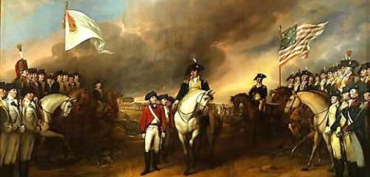
Victories in the West and South
The Patriots won victories in West and South, finalizing with the Battle of Yorktown

Slide 105
Task
Map and label the Battle of Yorktown using color to denote American/British victory

Slide 106
MAP OF BATTLE OF YORKTOWN

Slide 107
The Treaty of Paris
The Treaty of Paris (1783) contained these major provisions:
Great Britain recognized the independence of the United States
Northern border between the US and Canada was set from New England to the Mississippi River, primarily along the Great Lakes.

Slide 108
The Impact of the Revolution
For women, the Revolution did not produce any immediate gains.
experiences during the war did challenge traditional ideas about women.

Slide 109
For African Americans the results of the Revolution were mixed.
northern states abolished slavery
southern states made slavery more restrictive.

Slide 110
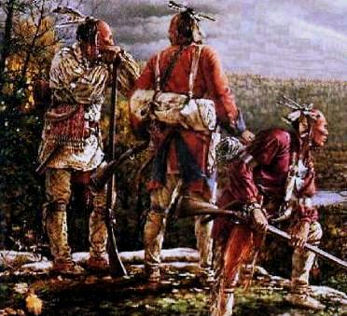
For Native Americans the
war’s outcome was a disaster.

Slide 111
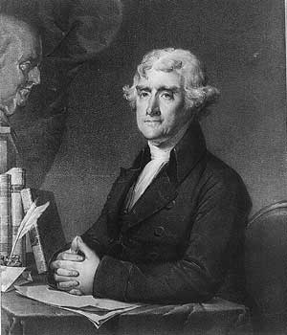
Perhaps the greatest effect of the Revolution was to spread the idea of liberty, both at home and abroad.

Slide 112
Did We Meet Our Objectives?
Can you?
Identify hardships of the Americans during the war
Explain how American victories in the West and South ended the war
Summarize the impact of the American Revolution

