Slide 1
1. Bellwork
Federalism ensures that state governments will not over take powers of the federal government and the powers of the federal government will not overtake the powers of the state.
1. Why do people today need the federal government?
2. Why are individual states prevented from making their own money?

Slide 2
Objectives – Lesson 1
As a result of this lesson, students will be able to:
Describe the early government of the United States
List some of the reasons for opposition to the Articles of Confederation.
Explain the causes and effects of Shays’ Rebellion.

Slide 3
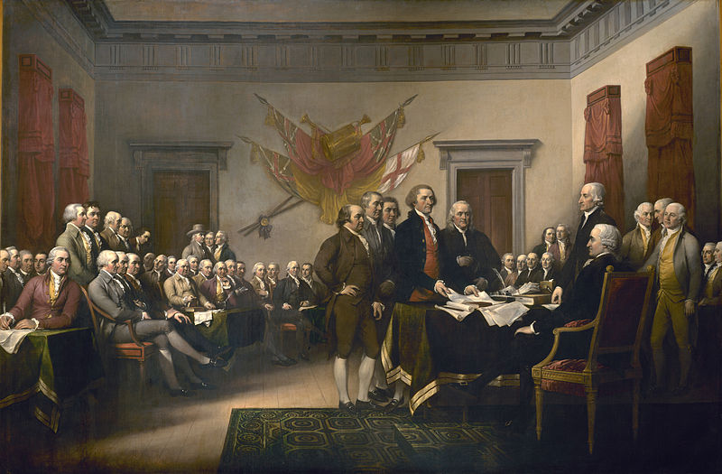
Unit 2:
Framing the American Government

Slide 4
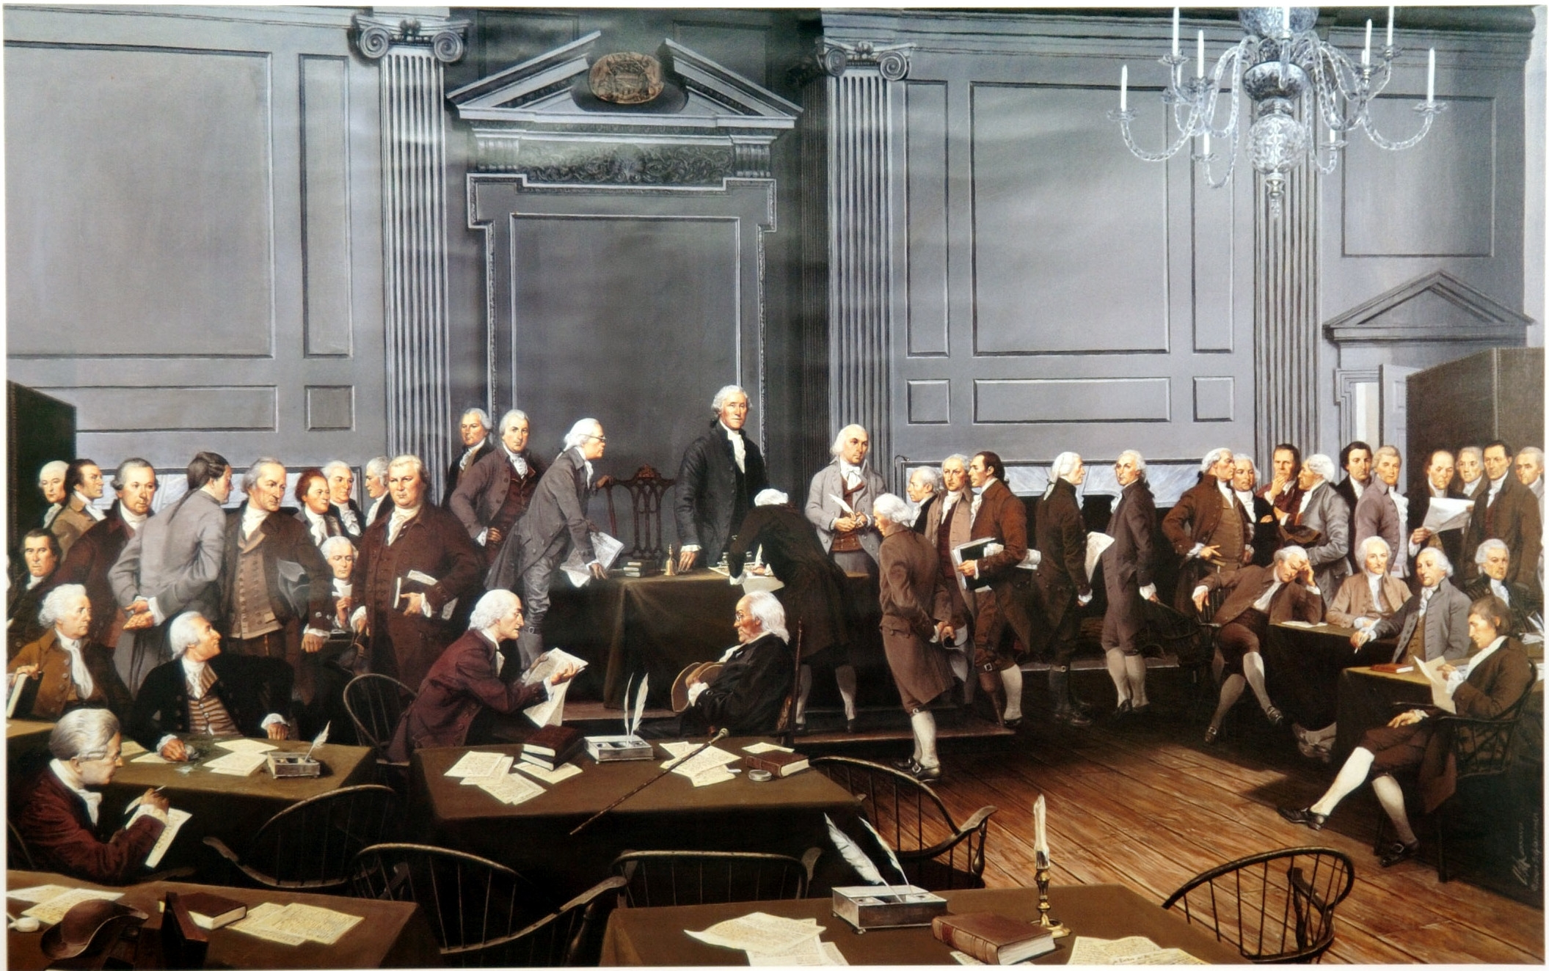
Chapter 5
The Constitution of the United States

Slide 5
2. Bell Work
What was the name of the first government of the United States?

Slide 6
Objectives – Lesson 1
As a result of this lesson, students will be able to:
Describe the early government of the United States
List some of the reasons for opposition to the Articles of Confederation.
Explain the causes and effects of Shays’ Rebellion.

Slide 7
Lesson 1: Government By The States
The national government under the Articles of Confederation was weak, and political power rested mostly with the states.

Slide 8
Early Government
Following the Revolution, Americans thought of themselves as citizens of individual states, not of a common nation.
The United States was not a nation as much as it was a confederation

Slide 9
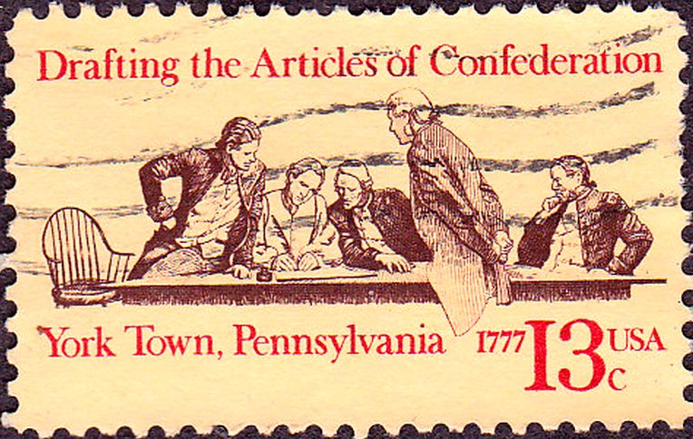
State governments had more power than the national government.
In 1777, the Continental Congress adopted a set of laws to govern the United States called the Articles of Confederation.
Articles established a limited national government, in which most of the power lay with the states.

Slide 10
The Articles of Confederation
One branch of government: the legislative branch, or Congress.
Congress carried out the duties of both the legislative and executive branches.
No national court system existed.
Congress could declare war and borrow money, but lacked the power to tax.

Slide 11
Opposition to the Articles
Americans agreed their new nation should be a democracy - a government by the people.
Specifically, they desired a republic, a government run by the people through their elected representatives.
People disagreed about how much influence citizens should have in government

Slide 12
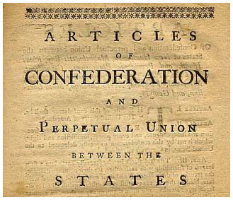
Economic Problems
Huge amounts of public and private debt were creating economic chaos in the new republic.
Many upper-class critics of the Articles felt that this problem was due to citizens having too much power in their state legislatures.

Slide 13
Bell Work
Describe the Articles of Confederation:
It’s structure and responsibilities

Slide 14
Lesson 1: Government By The States
The national government under the Articles of Confederation was weak, and political power rested mostly with the states.

Slide 15
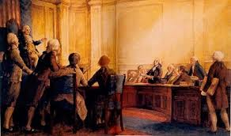
Concerns About Weak Government
A group called the Nationalists felt that a weak national government could not keep order.
They argued that European history had demonstrated that people were not naturally wise enough to have so much power over their own affairs.

Slide 16
The Annapolis Convention
In 1786, Nationalists held a conference in Annapolis, Maryland, to discuss economic problems.
Although the conference itself accomplished little, delegates agreed to call another convention in Philadelphia in 1787.

Slide 17
Shays’ Rebellion
Causes of Shays’ Rebellion
Massachusetts passed the heaviest direct tax ever
  Had to be paid in specie - rather than paper money.
A group of farmers led by Daniel Shays rebelled against taxes
Farmers drove off tax collectors and forced courts to close when their petitions were rejected.
Soon, open conflict raged as angry crowds rioted.

Slide 18
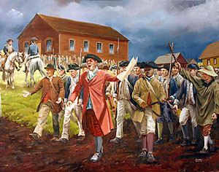
Effects of Shays’ Rebellion
Shays’ Rebellion demonstrated to many prominent Americans that a stronger national government was needed to avoid civil unrest.

Slide 19
Task – Quick Write
In your binders:
Title : Taxes and Conflict
  Refer to
    pre-Revolutionary British taxes
    Shays’ Rebellion
    issues over taxes today
    **Address why taxes are such a volatile issue**

Slide 20

Did We Meet Our Objectives?
As a result of lesson 1, students will be able to:
Describe the early government of the United States
List some of the reasons for opposition to the Articles of Confederation.
Explain the causes and effects of Shays’ Rebellion.

Slide 21
Bellwork
Define the word compromise
Tell about a time in your life when you had to compromise about an important issue in your life?

Slide 22
Objectives
As a result of this lesson, students will be able to:
List what the Founding Fathers hoped to achieve at the Constitutional Convention
Identify the issues that divided the convention, and explain how an agreement was reached
Identify the qualities that have made the Constitution a lasting document
Explain how the structure of government under the Constitution is divided

Slide 23
Lesson 2: The Constitutional Convention
In 1787, delegates to a convention in Philadelphia created a new plan of government, the Constitution of the United States.

Slide 24
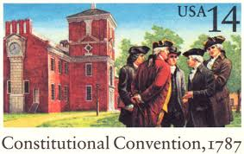
The Convention Assembles
Delegates from 12 of the 13 colonies met in Philadelphia to try to fix the problems of the new United States government.
This meeting, known as the Constitutional Convention, produced the United States Constitution the document that has governed the nation for 200 years

Slide 25
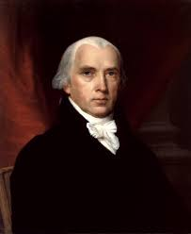
James Madison took detailed notes that would become the best record of the proceedings.
For his role, he became known as “the father of the Constitution.”

Slide 26
Divisions at the Convention
The convention had been empowered only to amend, or revise, the Articles of Confederation, not to replace them.
However, two plans for a new national government emerged at the convention.

Slide 27
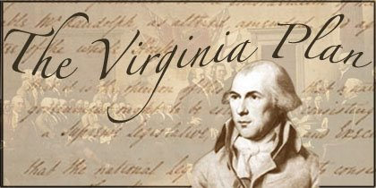
The Virginia Plan
Proposed a bicameral, or two-house, national legislature
Each state would send representatives in proportion to population
The new legislature would have the power to tax; the right to regulate foreign and interstate commerce; to veto; and to use force against a state, should that state defy national authority.

Slide 28

The New Jersey Plan
Proposed a unicameral, or one-house, national legislature, and the creation of executive and judicial branches
Each state would send the same number of representatives to the legislature.
The new legislature would have the right to tax and to regulate foreign and interstate commerce.

Slide 29
Reaching Agreements
In the Great Compromise, delegates agreed to create a legislative branch made up of two houses.
One house, the Senate, would have the same number of representatives from each state.
In the other house, the House of Representatives, representation would be based on state population.

Slide 30
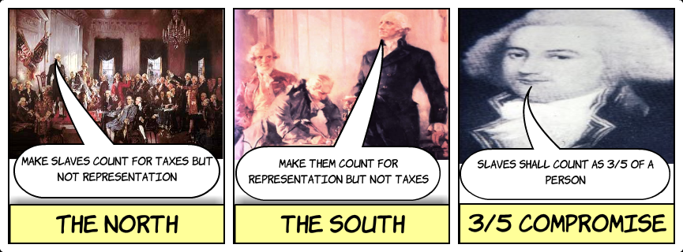
According to the Three-Fifths Compromise, three fifths of a state’s slave population would be counted when determining representation.
After further debate, the convention approved the final draft of the United States Constitution on September 17, 1787.

Slide 31
Bellwork
Explain, with detail, the Virginia and New Jersey Plans.

Slide 32
Lesson 2: The Constitutional Convention
In 1787, delegates to a convention in Philadelphia created a new plan of government, the Constitution of the United States.

Slide 33
Government Structure
Federal and State Powers
The Constitution created a federal system of government, in which power is shared among state and national authorities.
In a federal system of government, powers are divided into three categories:
  Some powers are reserved for the states only.
  Others are delegated to the federal government only.
  Still others, called concurrent powers, are held by both the federal government and state governments.

Slide 34
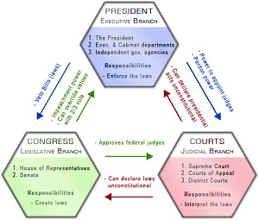
Separation of Federal Powers
Created to prevent any of the branches of government from acquiring too much power.
Each branch has its own area of authority, but no one branch has complete power over the government.

Slide 35
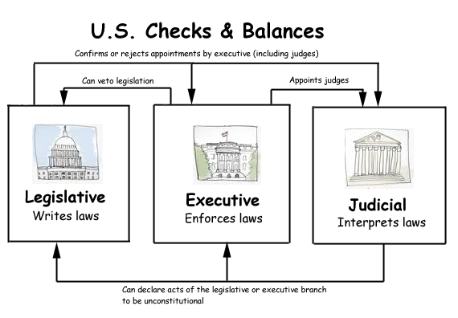
The Constitution also set up a system of checks and balances, in which each branch has the power to check, or stop, the other branches in certain ways.
This system prevents the misuse of power by any one branch.

Slide 36

Congress, the President, and the
Federal Courts
Congress
“Makes the law”
Each of the two houses of Congress was granted different powers.
Each was also designed with different methods of election and different term lengths, making the House more receptive to public opinion and the Senate more stable.

Slide 37

The President
“Carries out the law”
The President would be chosen by a group of electors from each state.
The candidate with the majority of votes in the electoral college, or group of electors, would become President.
The President was granted enormous powers, including the power to veto acts of Congress and to appoint judges for the federal courts.

Slide 38
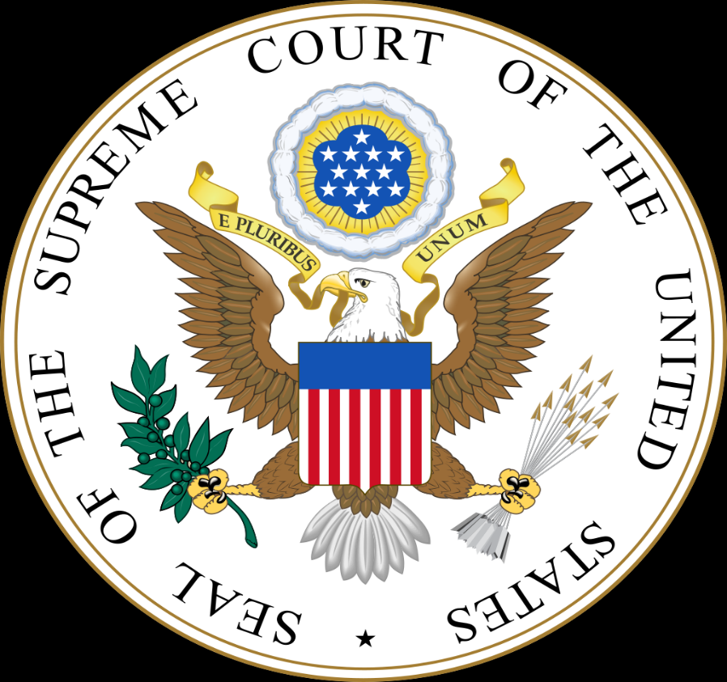
The Federal Courts
“Interpret the law”
The Constitution calls for one Supreme Court and several lesser courts, although the details of the federal court system were intentionally left vague.
Supreme Court justices would be appointed for life by the President with the consent of the Senate.

Slide 39

Did We Meet Our Objectives?
Can You?
List what the Founding Fathers hoped to achieve at the Constitutional Convention
Identify the issues that divided the convention, and explain how an agreement was reached
Identify the qualities that have made the Constitution a lasting document
Explain how the structure of government under the Constitution is divided

Slide 40
Bellwork
Do you think the federal government infringes too much on individual liberty?

Slide 41
Objectives
As a result of this lesson, students will be able to:
Explain how the position of the Federalists differed from that of the anti-Federalists
Detail how the Federalists won approval of the Constitution
Identify the arguments for and against the Bill of Rights

Slide 42
Lesson 3: Ratifying the Constitution
The states debated and then approved the new Constitution and a Bill of Rights soon was added to protect individual liberties.

Slide 43
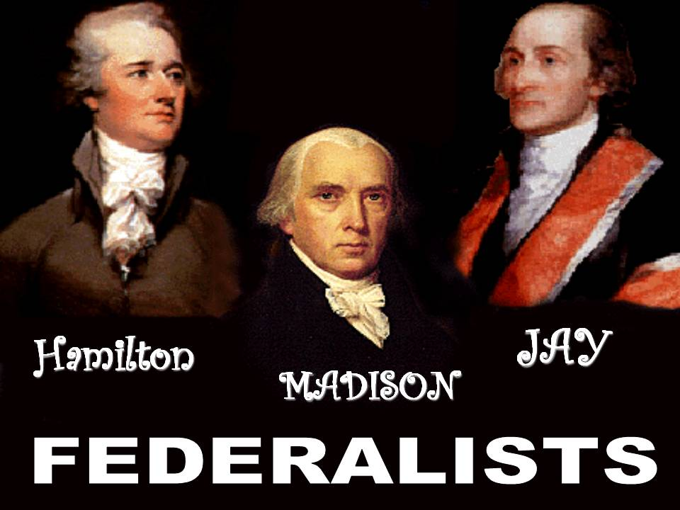
The Federalist View
For the Constitution to become law, 9 out of the 13 states had to ratify, or approve, it.
Those who favored the Constitution were called Federalists.
The Federalists included many Nationalists, such as George Washington, James Madison, and Alexander Hamilton, who favored a strong national government.

Slide 44
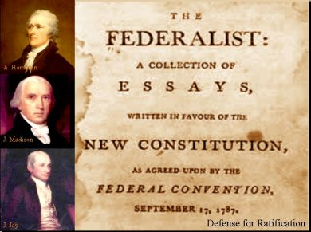
To make their case for the Constitution, the Federalists wrote a series of 85 essays, known as The Federalist Papers.
One issue addressed in these essays was that one powerful faction, or group concerned only with its own interests, could not control the government under the Constitution.

Slide 45
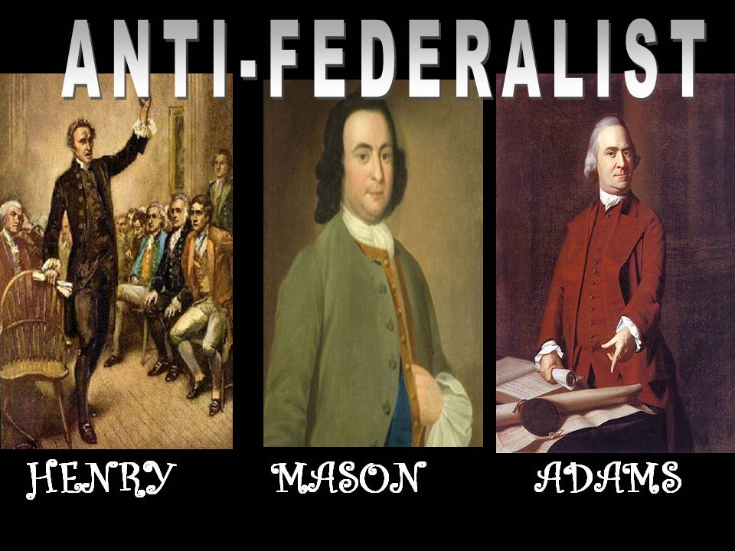
The Anti-Federalist View
Those who opposed the Constitution were called anti-Federalists.
Anti-Federalists believed that the Constitution threatened state governments and the rights of individuals.
The anti-Federalists included older revolutionary figures such as Patrick Henry, people in isolated areas who had less need for a strong national government, and some former Nationalists who wanted a national government but were unhappy with the Constitution.

Slide 46

According to the anti-Federalists, a President would be too similar to a king, a figure whose control American patriots had fought to escape.
Anti-Federalists also objected to the proposed federal court system.
While the Federalists feared the people more than government, the anti-Federalists feared government more than the people.

Slide 47
Why the Federalists Won
The Federalists had several advantages over the anti-Federalists.
These included:
  The Federalists used flaws of the Articles of Confederation
  The Federalists were a united, well-organized national group, the anti-Federalists were local politicians.
  The Federalists had an actual document and plan which they could defend. The anti-Federalists had no plan to offer.
  The Federalists had the support of George Washington, a respected Revolutionary War hero.

Slide 48
For and Against the Bill of Rights
For the Bill of Rights
Many believed the national Constitution, like most state constitutions, should include a declaration of the rights of the people.
Congress proposed twelve constitutional amendments designed to protect citizens’ rights.
Ten of these amendments were ratified by the states.
These ten amendments became known as the Bill of Rights.

Slide 49
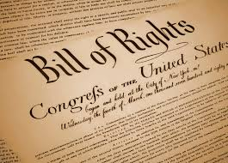
Against the Bill of Rights
Federalists saw no need for the amendments.
Federalists believed the Constitution, the people and the government were the same.
The people needed no additional protection of rights.

Slide 50
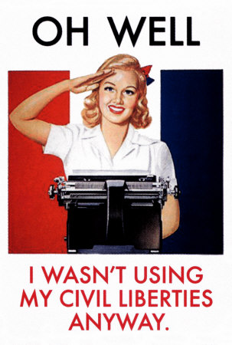
The Bill of Rights
1st Amendment
Ensures Civil Liberties:
  Guarantees freedom of speech
  Freedom of the press
  Freedom of religion
  The right to assemble peacefully
  Guarantees that Congress can pass no laws that would restrict those freedoms
  The right to complain about whatever they choose to any government official

Slide 51
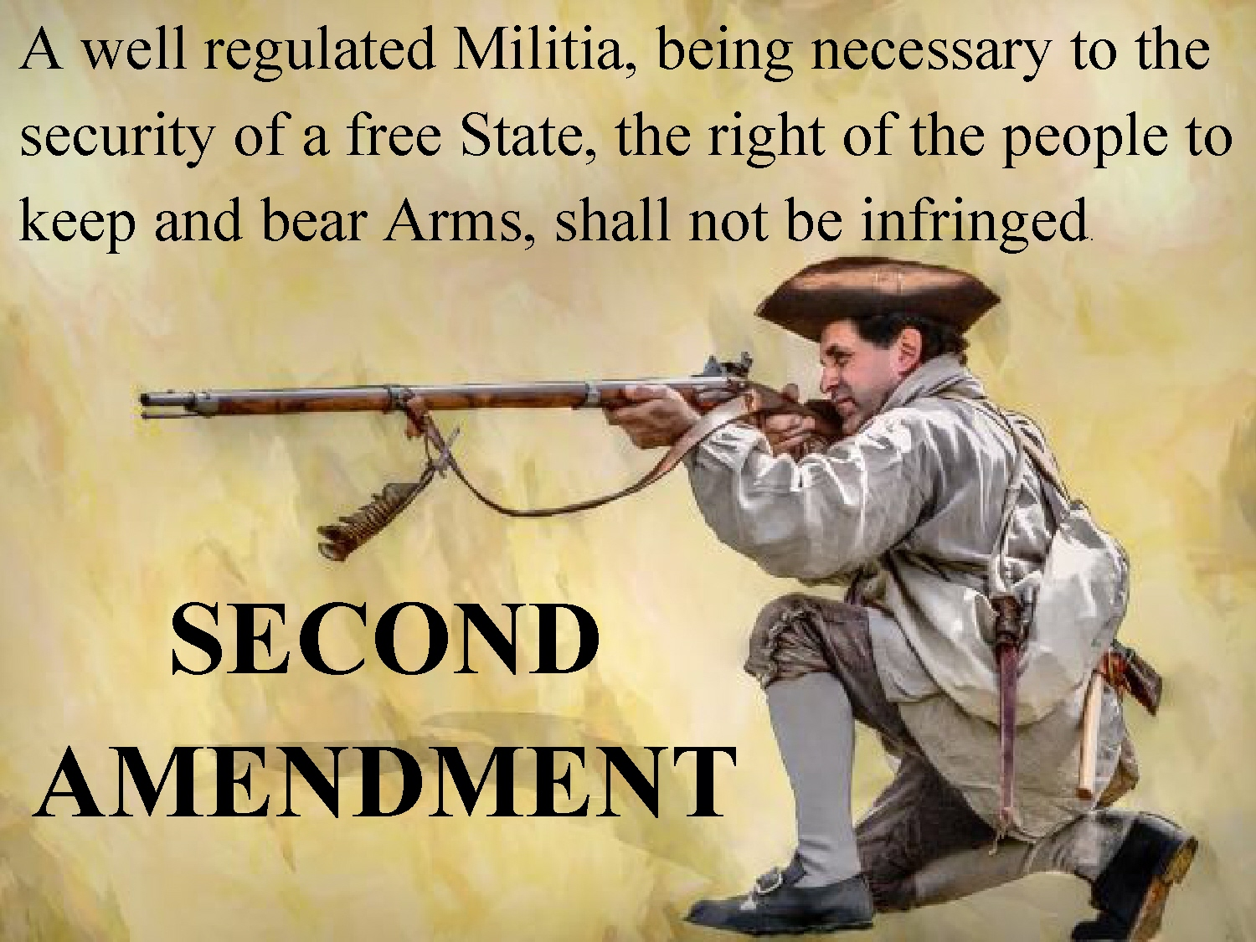
2nd Amendment
Keeping and Bearing Arms:
  The exact meaning is unclear
  The country has the right to organize a “well regulated Militia” and those people can have guns
  Both Congress and state legislatures have passed laws regulating the private ownership and use of weapons by individuals.

Slide 52
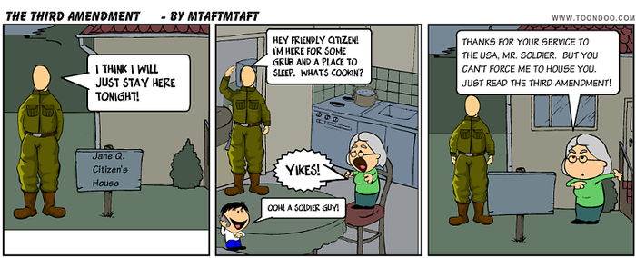
3rd Amendment
Protection from the Military:
  The result of the constant takeover of citizens’ homes by the British during the Revolutionary War.
  Protects individual homes from the military and says that, during peacetime or wartime, “no Soldier shall . . . Be quartered in any house, without the consent of the owner.

Slide 53

4th Amendment
Search and Seizure:
  Requires the use of search and arrest warrants from a judge to search either a person or a home.

Slide 54
5th Amendment
Protects people from testifying against themselves in a criminal trial
  Also says that a person cannot be tried for the same crime twice
  Says that a person cannot be denied due process of law.
  Due process of law – guards individual rights from infringement by state or federal governments.

Slide 55

6th Amendment
The right to a defense:
  Gives the right to every defendant to be aware of any charges against him
  As well as the right to an attorney, regardless of whether the defendant can afford one
  And the right to a jury trial

Slide 56
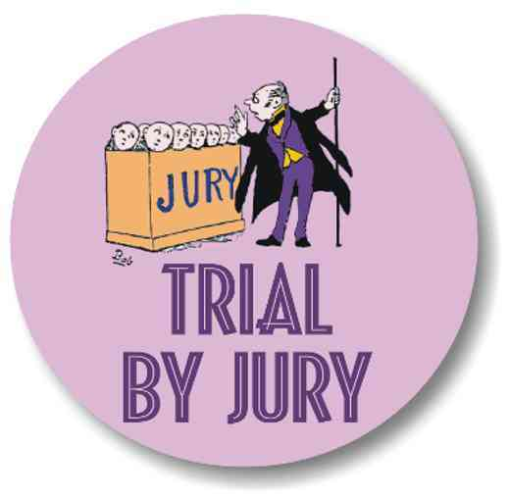
7th Amendment
The right to a trial:

Slide 57
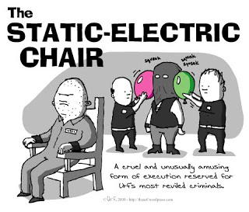
8th Amendment
Barring cruel and unusual punishment:
  Guards against any excessive bail, fines, or cruel and unusual punishment for alleged criminals and criminals

Slide 58
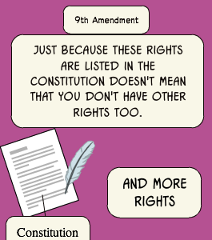
9th Amendment
Ensuring fundamental rights:
  Dictates that the rights retained by the people can be contradicted by the Constitution.
  Added to ensure fundamental rights of the people that are not included in the Constitution

Slide 59
10th Amendment
Protecting states’ interests:
  Protects states from the federal government.
  Establishes that powers not given to the national government – or denied to the states – by the Constitution belong to the states or to the people.

Slide 60

Did We Meet Our Objectives?
Can You?
List what the Founding Fathers hoped to achieve at the Constitutional Convention
Identify the issues that divided the convention, and explain how an agreement was reached
Identify the qualities that have made the Constitution a lasting document
Explain how the structure of government under the Constitution is divided

Slide 61
Bellwork
Make a list of what comes to mind when you think of Washington, D.C.

Slide 62
Objectives
As a result of this lesson, students will be able to:
Identify the new leaders selected by President Washington
Explain the challenges Washington’s government faced
List the details that were involved in planning the capital city

Slide 63

Lesson 4: The New Government
President Washington led the effort to create an effective federal government that would earn the respect of the American people and of other nations.

Slide 64
You’re in the HOT SEAT!!
What subjects did Washington pursue in school ?
What position was Washington appointed to at the Second Continental Congress?
How long did the American Revolution last?
Who did Washington force to surrender at Yorktown?
What policy did Washington insist upon during the time of the war between the British and the French?

Slide 65
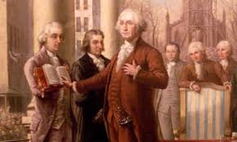
The New Leaders
On April 30, 1789, George Washington took the oath of office as the first President of the United States.
Washington’s inauguration, or official swearing-in ceremony, was attended by thousands.

Slide 66
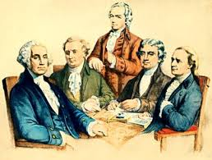
Leading Federalist John Adams of Massachusetts became Vice President.
Washington also selected a Cabinet, a group of federal leaders who advise the President and head national agencies.

Slide 67
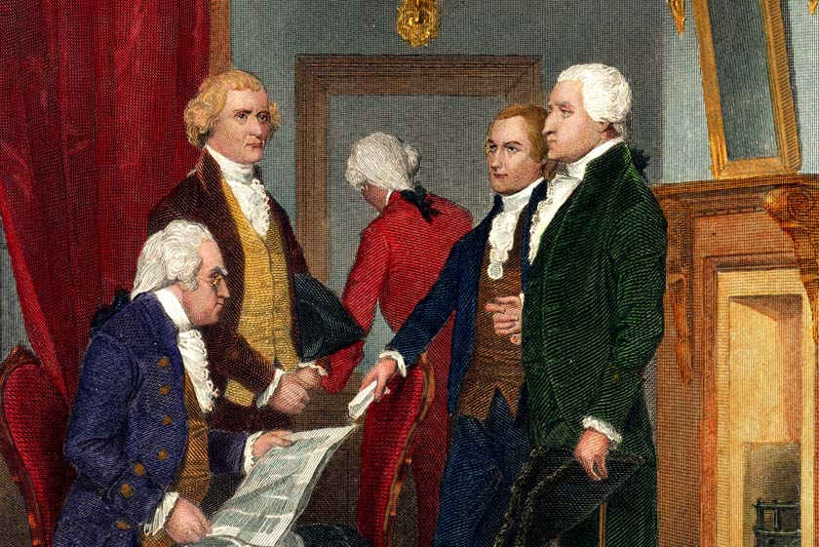
Washington’s Cabinet included many prominent Americans.
He named Edmund Randolph of Virginia to the post of Attorney General and kept Henry Knox as Secretary of War.
Thomas Jefferson was named Secretary of State and Alexander Hamilton became Secretary of the Treasury.

Slide 68
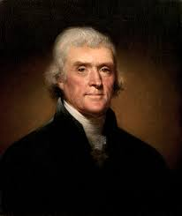
Jefferson and Hamilton
Secretary of State Jefferson
Strict Constructionists
Favored weak national government
Opposed national bank
Favored paying off national debt
Pro-agriculture
Against standing army/navy
Common man should hold political power
Pro-French
More diverse

Slide 69
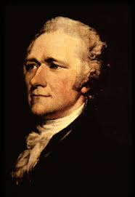
Treasury Secretary Hamilton
Loose Constructionist
Strong national government
National bank
Using federal debt to establish credit
Pro business
Strong standing army/navy
Political power should be given to wealthy, educated
Pro-British
Generally businessmen

Slide 70
Washington’s Government
Washington knew that during his first administration, or term of office, he and his officials were establishing precedents for how to govern.
A precedent is an act or statement that becomes an example, rule, or tradition to be followed.

Slide 71
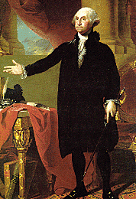
Washington worked to establish a tone of dignity in his administration.
The President held regular receptions for government officials and was escorted by soldiers when he traveled.

Slide 72
Planning a Capital City
The Need for a Capital City
During Washington’s first year in office, the government resided in New York City.
In 1790, the capital was moved to Philadelphia while a new capital could be planned and built.
The Residence Act of 1790 specified a 10-square-mile stretch of land on the border between Maryland and Virginia for the new capital.
This area, to be called the District of Columbia, would be governed by federal authorities, not by either state.

Slide 73

Did We Meet Our Objectives?
Can you?
Explain how the position of the Federalists differed from that of the anti-Federalists
Detail how the Federalists won approval of the Constitution
Identify the arguments for and against the Bill of Rights

Slide 74
Bellwork
Write down if you consider yourself a Democrat, Republican, Independent, or another minor party.
Define the political goals of the party you identify with

Slide 75
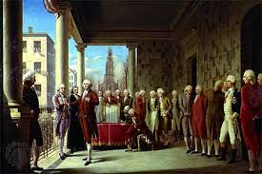
Chapter 6
The Origins of American Politics

Slide 76
Objectives
As a result of this lesson, students will be able to:
Explain Alexander Hamilton’s program for dealing with national and state debt
Identify how foreign policy issues divided Americans
List the issues that led to the emergence of political parties

Slide 77
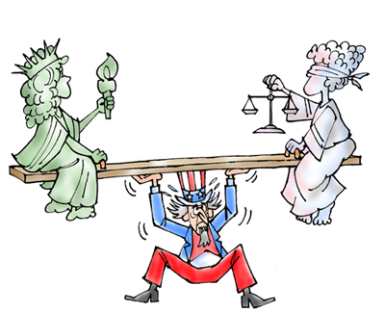
Lesson 1: Liberty Versus Order in the 1790s
Americans became sharply divided in the 1790s over whether order or liberty was more important

Slide 78
Class Activity
In your notebook, answer the following questions:
  which is more important to American society, “liberty” or “order”? Why?
  How might liberty and order come into conflict? Give examples

Slide 79
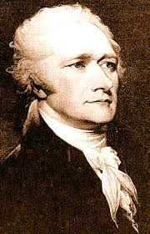
Hamilton’s Program
Looked to expand the federal role in the economy
Approved a plan for federal government to take over debts of the states acquired during Revolutionary War

Slide 80
Federal debt was already $75 million –
  why would the federal government agree to assume the state debts as well?
Assuming state debt would strengthen the federal government – lenders don’t want debtor to fail

Slide 81
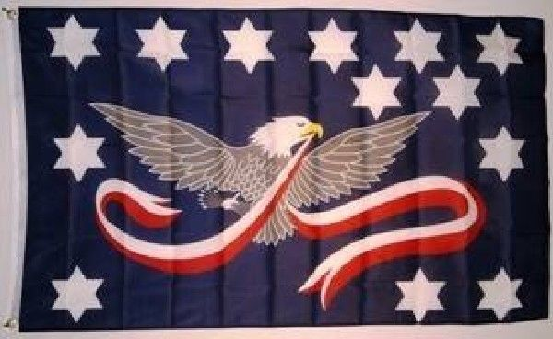
Hamilton’s Strategy
To help raise money Congress created a tariff – tax on imported goods
Congress placed a tax on distilled liquors that was called the whiskey tax

Slide 82
National Debt
National Debt - - total amount of money owed by federal government to citizens or other nations who invested in the US
In 1791, the national debt was $75 million and the population was about 4 million people. So each person’s share of the national debt was about $18.75
Today the national debt is over $18 trillion and the population is about 319 million. So each person’s share of the national debt is about $57,000.

Slide 83
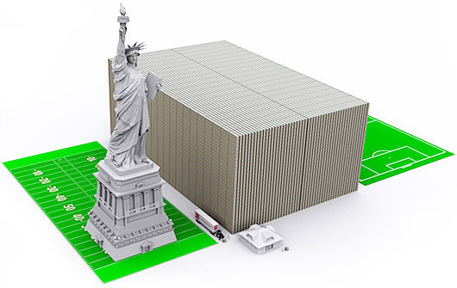
Can You Spend a Trillion $$$
Write down everything you would buy if you had a trillion dollars.
  Make an estimate of how much it would cost
Can you spend one trillion dollars?

Slide 84
Bell Work
America attempted to stay neutral when Britain and France went to war after the American Revolution.
  List other events from history where the US tried to remain neutral.

Slide 85
Essential Question
How did foreign policy issues divide Americans?

Slide 86
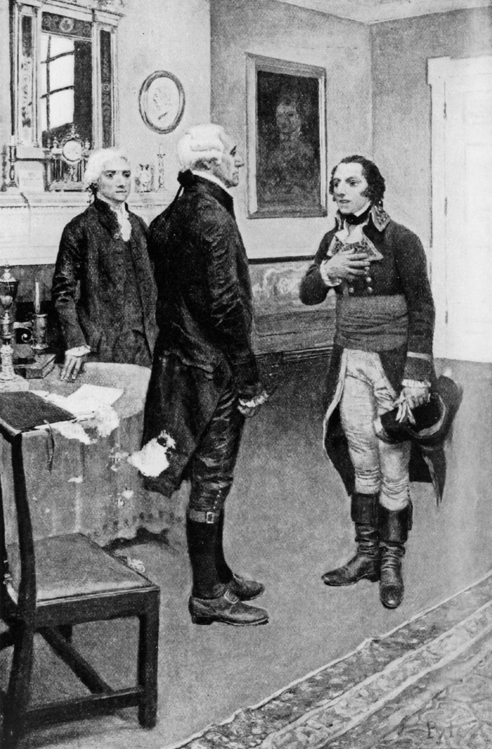
Foreign Policy Issues
Americans split over the French Revolution
Citizen Genet
  Tried to convince Americans to fight against the British
Proclaiming American Neutrality
  Could not offend the British
  Could not abandon the French

Slide 87
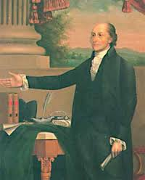
Jay’s Treaty
Britain agreed to leave the Northwest Territory
Expanded trade
Could not stop British from searching American ships for British subjects

Slide 88
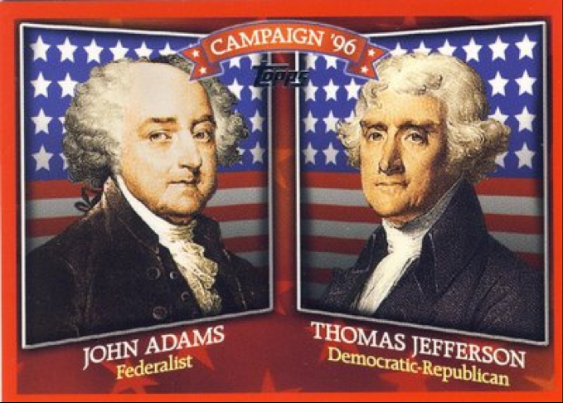
Political Parties Emerge
Jeffersonian Republicans – resistance to the Federalists
Election of 1796 – Federalists (John Adams) won
  Jefferson came in second which meant he would become Vice President

Slide 89
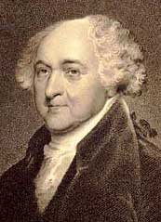
Election of 1796
Second President
Lacked the prestige of Washington
Rise of political parties
Threat of war from abroad with the French over Jay’s Treaty
French began seizing American ships in French harbors

Slide 90
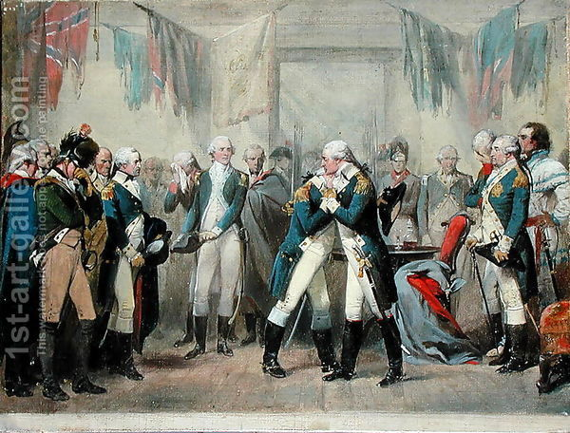
Washington Says Farewell

Slide 91
Washington’s Legacy
Washington was famous for his honesty, dignity, an self-control
He was very popular in his first four years
Problems clouded his second term
Many distrusted the government
Many disliked Hamilton’s economic plans
Jefferson resigned in 1793
Divisions in the government developed

Slide 92

Did We Meet Our Objectives?
Can You?
Explain Alexander Hamilton’s program for dealing with national and state debt
Identify how foreign policy issues divided Americans
List the issues that led to the emergence of political parties

Slide 93
Bellwork
What do you believe are the strengths needed to be President?

Slide 94
Objectives
As a result of this lesson, students will be able to:
Identify the actions John Adams took as President
Explain why the election of 1800 was a turning point
Explain what was significant about the transfer of power between parties in 1801

Slide 95
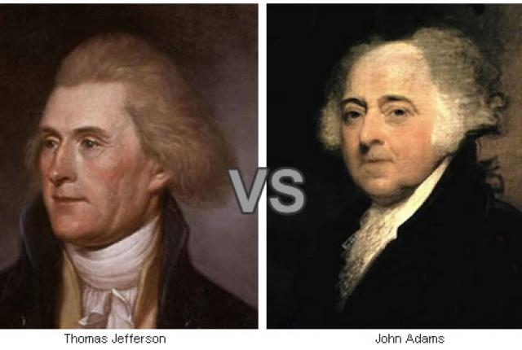
Lesson 2: The Election of 1800

Slide 96
YOU’RE IN THE HOT SEAT
Where and when was John Adams born?
What ended the quasi war?
Where did John Adams go to retire?
What were John Adams’ last words?
Which war did John Adams help negotiate a peace treaty?
How many commissioners did John Adams send to France?

Slide 97
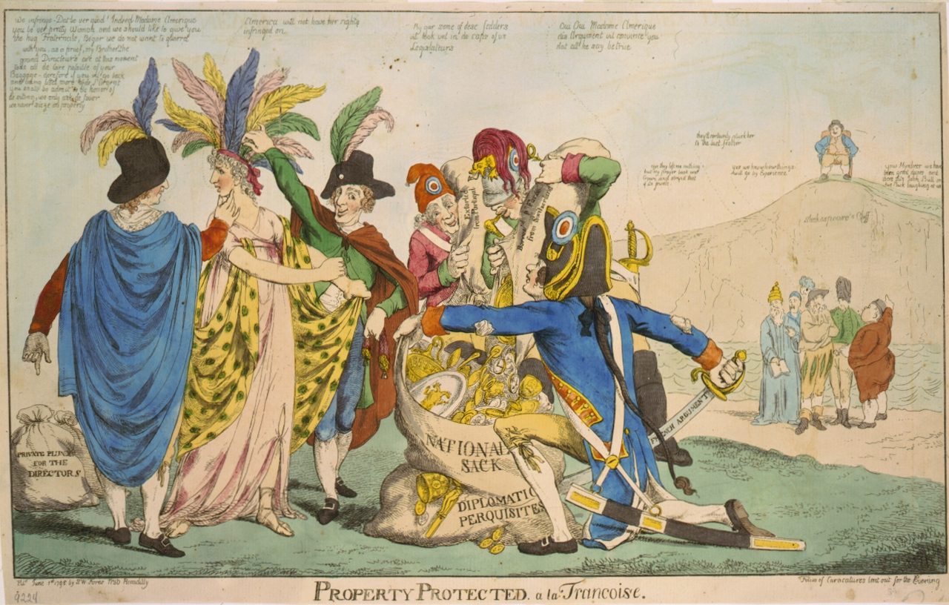
XYZ Affair
John Adams as President
French were seizing American ships
X, Y, and Z were French agents sent to demand a bribe from America
Americans returned home
Quasi war with France

Slide 98
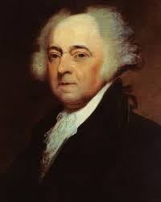
Alien & Sedition Acts
President gained the right to imprison or deport citizens of other countries residing in the U.S.
Persons who wrote, published, or said anything “of a false, scandalous, and malicious” nature against the American government or its officials could be jailed or fined

Slide 99
Virginia and Kentucky Resolutions
Jefferson, Madison, and others felt the Sedition Act violated free speech
Legislatures of two states came up with “null and void” idea
Stated that states had the right to judge whether federal laws agreed with the Constitution

Slide 100
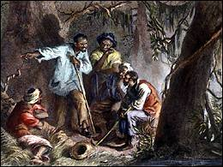
Prosser’s Rebellion
Gabriel Prosser, a blacksmith, in Richmond, Virginia, led a rebellion. It failed and twenty of them were executed.

Slide 101
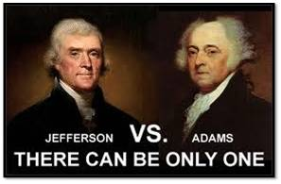
Election of 1800
Jefferson versus Adams
Jefferson did not gain a majority so election was decided in the House of Representatives

Slide 102

Did We Meet Our Objectives?
Can You?
Identify the actions John Adams took as President
Explain why the election of 1800 was a turning point
Explain what was significant about the transfer of power between parties in 1801

Slide 103
Bell Work

Slide 104
Objectives
As a result of this lesson, students will be able to:
Explain how Jefferson reduced the power of the national government
Identify the problem Jefferson had with the federal courts
Explain how Jefferson achieve his program in the West
Explain how Jefferson won reelection in 1804
Detail how Jefferson responded to increasing tension with Europe

Slide 105
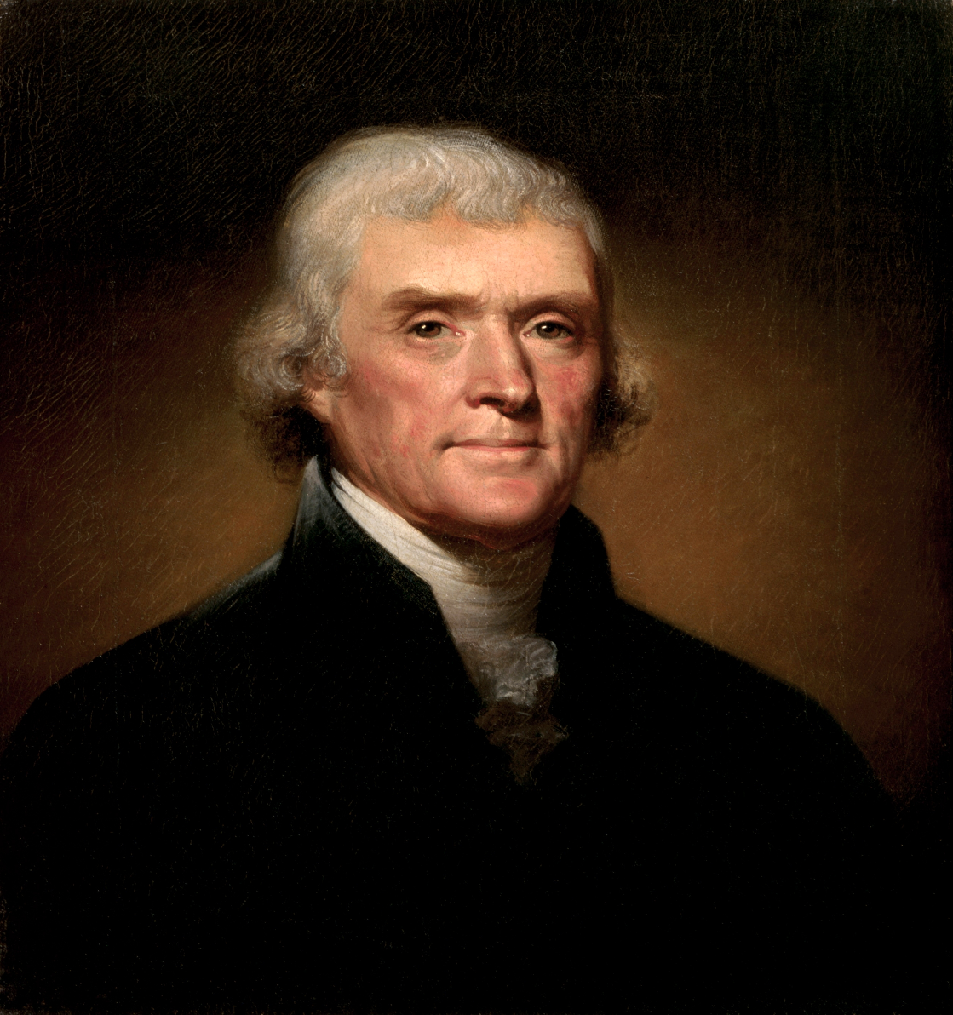
Lesson 3: Jefferson Administration

Slide 106
YOU’RE IN THE HOT SEAT!!
Where did Thomas Jefferson study?
Who did Jefferson succeed as minister to France?
How many votes did Jefferson come within for President in 1796?
What tax did Jefferson eliminate?
How much did he reduce the national debt?
Where did Jefferson retire?

Slide 107
Reducing Government
Jefferson reversed much of what the Federalists had done, such as presidential style; addressed as “Mr. President”
Reduced taxes
Cut the bureaucracy – the departments and workers that make up the federal government
Slashed the size of the army to 3,000 men
Let stand the Bank of the United States since charter would expire in 1811

Slide 108
Judiciary Acts
Judiciary Act of 1789: created a national court system with three circuit courts and thirteen district courts, headed by the Supreme Court
Stated that the Supreme Court would settle differences between state and federal laws

Slide 109
Judiciary Acts
Judiciary Act of 1801: decreased the number of Supreme Court justices and increased the number of federal judges. Adams filled the new posts to have more Federalists judges;
Known as midnight judges
Angered Jefferson who felt that he should appoint new judges from his political party

Slide 110
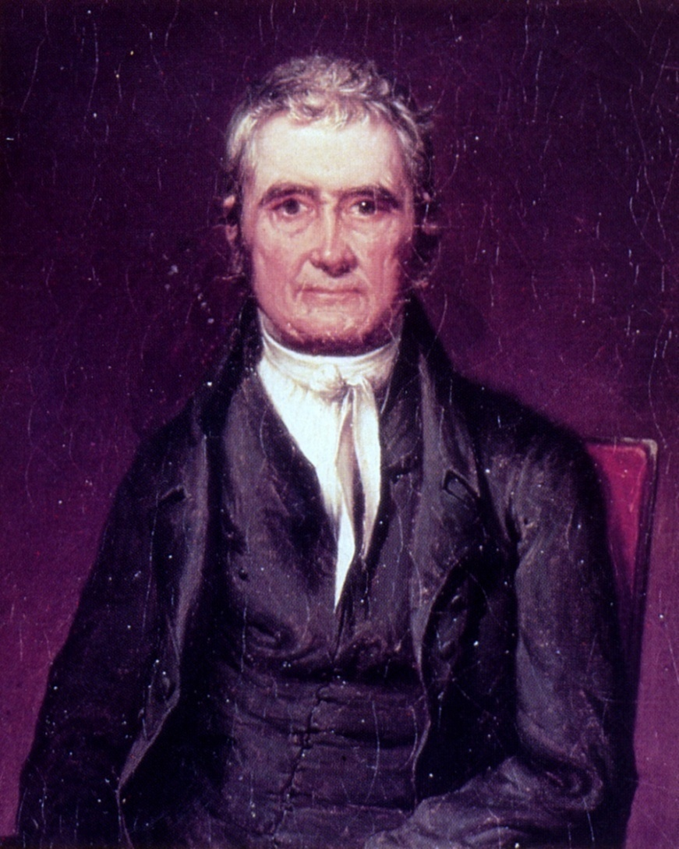
John Marshall
Federalist leader
Became Chief Justice in 1801 and held post for 34 years
Established principle of constitutional law – judicial review
Insisted federal laws were superior to state laws

Slide 111
Marbury v. Madison
Adams appointed Marbury as justice of the peace for the District of Columbia
Secretary of State Madison never delivered the papers
Marbury sued Madison
Chief Justice Marshall ruled against Marbury; declared part of the Judiciary Act of 1789 unconstitutional
Established the power of judicial review

Slide 112
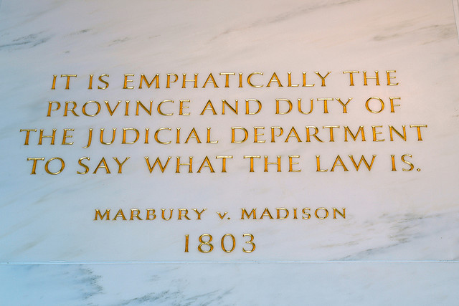
Judicial Review
Enables federal courts to review state laws and court decisions
Can decide if laws passed by Congress are constitutional

Slide 113
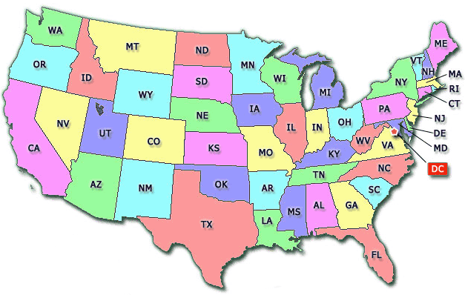
Bell Work
Use the map on page 199 and the map below to list all of the modern states involved in the Louisiana Purchase.

Slide 114
Essential Question
What were the goals of the Jefferson Administration and how were they achieved?

Slide 115
Louisiana Purchase
France controlled New Orleans
Jefferson sent James Monroe to Paris to buy New Orleans for $10 million, but he bought all French land for $15 million
Doubled the size of the U.S.

Slide 116
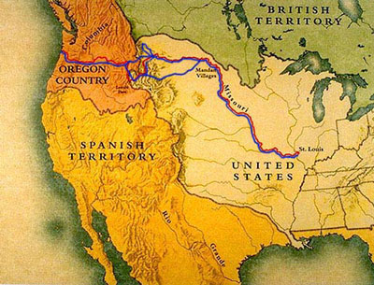

Slide 117
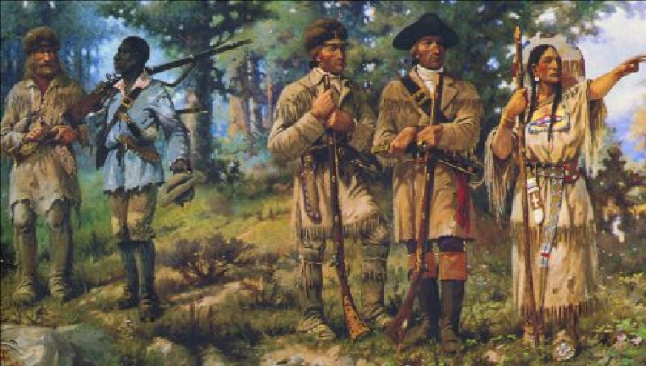
Lewis & Clark
Expedition began spring 1804
Search for river routes to the western ocean
Make contact with Native Americans
Gather information about natural resources

Slide 118

Increasing Tension with Europe
Embargo of 1807 – outlawed almost all trade with foreign countries

Slide 119

Did We Meet Our Objectives?
Can You?
Explain how Jefferson reduced the power of the national government
Identify the problem Jefferson had with the federal courts
Explain how Jefferson achieve his program in the West
Explain how Jefferson won reelection in 1804
Detail how Jefferson responded to increasing tension with Europe

Slide 120
Bell Work
Define the words accommodate and assimilate
When have you accommodated someone/something, when have you assimilated into a new group

Slide 121
Objectives
As a result of this lesson, students will be able to:
Explain what led to war between the United States and Native Americans in the Old Northwest
Identify the different ways Native American leaders reacted to United States expansion

Slide 122

Native American Resistance
Native American response to American expansion differed from acceptance to resistance

Slide 123

War in the Old Northwest
Battle of Fallen Timbers
  Native Americans with British waged war against American expansion
Treaty of Greenville
  Indians relinquished southern 2/3rds of Ohio
  Ohio River no longer used as boundary
  Greatly weakened Native Americans

Slide 124
Native American Reaction
1. Accept white culture
2. Blending Indian and American cultures
3. Returning to Indian religious traditions
4. Taking military actions

Slide 125

Accepting White Culture
Adopted some American customs
Tried to live peacefully with settlers

Slide 126

Blending Cultures
Rebirth of culture that would blend customs of both Native Americans and Americans
Urged to abandon war and focus on rituals

Slide 127

Returning to Traditions
Rejection of European ways and a return to tradition
Had warlike attitude

Slide 128

Military Action
Tecumseh believed that Native Americans must unite the Native American groups to fight the Americans
Battle of Tippecanoe – William Henry Harrison was attacked

Slide 129
Result
Tecumseh dies in Canada during the War of 1812 at the Battle of the Thames
Tecumseh does not accomplish goal of uniting Native Americans
Tecumseh and Tenskwatawa showed defiance and earned respect for their people and culture

Slide 130

Did We Meet Our Objectives?
Can You?
Explain what led to war between the United States and Native Americans in the Old Northwest
Identify the different ways Native American leaders reacted to United States expansion

Slide 131
Bell Work
From the map on page 225, make a list of the first 5 events in the War of 1812

Slide 132
Objectives
As a result of this lesson, students will be able to:
Explain why war broke out with Britain in 1812
Explain how the war’s end affected the United States
Identify the issues that led to the Missouri Compromise

Slide 133

Lesson 5:War of 1812

Slide 134
Reasons for War
Americans believed the British were encouraging the Native Americans to attack
War Hawks (Clay and Calhoun) wanted Britain out of North America
British interference with shipping-
impressment: the act of forcing people into military service

Slide 135

Land War
Tried to defeat British in Canada; defeated by the British in summer of 1812; Americans were poorly equipped and led
Battle of the Thames, 1813, Americans defeated British and Native Americans, including Tecumseh

Slide 136

Naval War
American vessels outnumbered 20 to 1
Perry defeated British fleet on Lake Erie, protecting northern border
British blockaded coast

Slide 137

Baltimore
British bombarded Fort McHenry
Francis Scott Key watched and wrote the Star-spangled banner

Slide 138

Washington, D.C.
British seized Washington and burned the White House and the Capital

Slide 139
War Ends
The Hartford Convention 1814: New England considered leaving the Union; called for constitutional amendments to increase New England’s political power
Treaty of Ghent
-Representatives met in Belgium
-All old boundaries between the U.S. and Britain were restored

Slide 140

Battle of New Orleans
Two weeks after treaty signed
General Andrew Jackson defeated the British
Battle unified country and made Jackson a hero

Slide 141
Missouri Compromise
Slavery would not be restricted in Missouri
Maine admitted as free, non-slave state
Territory of Louisiana Purchase north of 36°30N latitude would be non-slave territory

Slide 142

Did We Meet Our Objectives?
Can you?
Explain why war broke out with Britain in 1812
Explain how the war’s end affected the United States
Identify the issues that led to the Missouri Compromise

